Slide 1
Environmental Considerations for
Deep Draft Navigation
Presenter:
Ms. Jenny L. Jacobson
Date:
May 17, 2011
Charleston, South Carolina

Slide 2
Environmental Considerations - Deep Draft Navigation
Upfront Cheat Sheet Notes
Occur in environmentally sensitive coastal areas (rivers, estuaries, coastal inlets, nearshore marine)
Have potential for complex & large scale environmental impacts – require complex studies and evaluation
Environmental considerations take time and $$$
Environmental compliance for DDN is not static – i.e. not one and done – it’s alive Change will happen.
Interdisciplinary PDT needed for environmental compliance
Many environmental laws and regulations involved
Coordination with Agencies & Public is critical. Compliance is a continual & collaborative process. You can never have enough!
  Early, Frequent, Complete (need transparency), Modern Tools
The NEPA process can help us make better projects

Slide 3
Environmental Laws Affecting USACE DDN Mission
  National Environmental Policy Act
  Fish and Wildlife Coordination Act
  Clean Water Act
  Coastal Zone Management Act
  Marine Protection, Research & Sanctuaries Act
  Resources Conservation and Recovery Act
  Toxic Substances of Control Act
  Coastal Barrier Resources Act
  Clean Air Act
  Endangered Species Act
  Marine Mammals Protection Act
  Magnuson-Stevens Fishery Management & Conservation Act
  Migratory Bird Treaty Act
  National Historic Preservation Act

Slide 4
Impact of NEPA
68
NHPA
FFCA
66
NEEA
NAGPRA
64
HMTUSA
PPA
62
CAAA
WRDA
60
OPA
NAWCA
APA
58
WRDA
ODBA; SPA
56
FEMIA
AIA
54
FEAPRA
NWPA
52
WSRA
UMTRAAA
50
TSCA
FIFRA
48
LCCA
46
MWTA
FHSA
44
FCRPA
FLPMA
42
RGIAQR
WQA
40
HSWAA
EPCRA
38
CERCLA
36
CUMULATIVE NUMBER OF LAWS AND AMENDMENTS
UORA
SARA
34
UMTRCA
NWPA
32
CWA
ARPA
30
RCRA
AIRFA
28
TSCA
SMCRA
26
SDWA
FLPMA
24
CZMA
HMTA
22
MPRSA
ESA
20
FIFRA
NCA
18
OSHA
MMPA
16
FWPCA
14
NEPA
PWSA
12
NWRSAA
WSRA
10
SWDA
CAA
8
WPFPA
FHSA
NHPA
6
FDCA
FIFRA
LWCFA
4
FWCA
CAA
FWPRA
2
MBTA
CAA
0
2000
1900
1910
1920
1930
1940
1950
1960
1970
1980
1990
YEARS

Slide 5
National Environmental Policy Act
(Overarching Concept)
A Collaborative Process
ESA
MPRSA
NHPA
CAA
CWA
FWCA
EFH
MSFMCA
CZMA
Notes:
NEPA is thought of as the umbrella overseeing all other environmental compliance. Compliance with the individual acts is required to comply with NEPA. Compliance with the one doesn’t imply compliance with the other.

Slide 6
National Environmental Policy Act 1969
42 U.S.C. 4321 et seq.
Purpose
  “…to declare a national policy which will encourage productive and enjoyable harmony between man and his environment…”
History
Rachel Carson: Silent Spring ’63
Cuyahoga River Burning ’69
S. 1075, Senator Jackson ’69
HR 6750 Rep. John Dingell ‘69
Signed by President Nixon 1 Jan 1970, PL 91-190

Slide 7
National Environmental Policy Act 1969
Requires all Federal agencies to consider environmental consequences of Federal actions - aimed at the Federal government and not at individuals or the states.
For "major” Federal actions significantly affecting the quality of the human environment, a detailed statement required by the responsible official on ... the environmental impact of the proposed project ....EIS
The idea of NEPA - procedural steps be taken by an agency prior to the initiation of any project to assure that the decision maker and the public would be apprized of the environmental consequences of the project. NEPA puts the environment on equal footing with other factors, such as economics, defense needs, etc.
NEPA requires an agency to take a hard look at environmental impacts, but that agency can still decide to take the most destructive course of action if it wants. There is no requirement in NEPA that the agency bias its decision in favor of protection of public health and the environment.
The detailed evaluation required before a 'critical decision‘ made to act. This threshold is reached when the agency proposes to make an irreversible and irretrievable commitment of resources to a project.
The key things that must be identified and considered are: reasonable alternatives to the proposed action, the direct impacts of each alternative (including the proposed one), the indirect impacts, and the cumulative impacts of the proposed action with other nearby or similar actions.
Agency must have site-specific data and information on which to base those considerations.

Slide 8
NEPA No No’s
A court may reverse an agency's decision under NEPA if the agencies decision was:
  arbitrary
  capricious
  an abuse of discretion or otherwise not in accordance with process & law
Public opportunity for comment in the NEPA process - required
Agency NEPA procedures must insure that environmental information is available to public officials and citizens before decisions are made and before actions are taken. Requires full and open disclosure of all facts used in making the decision.
The information must be of high quality – a hard look.
Accurate scientific analysis, expert agency comments, and public scrutiny are essential to implementing NEPA.

Slide 9
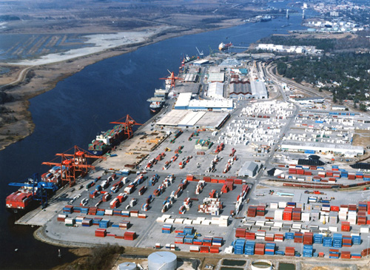
National Environmental Policy Act 1969
CEQ Regulations (40 CFR 1500.1)
USACE ER 200-2-2: Environmental Quality - Procedures for Implementing NEPA, 4 March 1988
Collaboration!!!!
  Lead Agency – USACE
  Cooperating Agencies
  Scoping – public input
Process for EIS
  Draft – 45 day public review
  Final – 30 day public review
  ROD
  Requires full and open disclosure of all facts used in making the
  decision (not better documents – but better decisions)
Notes:
Rhetorical Question: What are cooperating agencies and how might they benefit you?
Downside is the Corps will have to accept the segment the agency produces. Potential for disagreements has limited the usefulness of this approach. Scheduling issues are also a factor.
Can be a significant factor in preventing potential referrals and lawsuits.
For a listing of agency statutory expertise see Appendix II. FR vol. 53, Feb 3, 1988, Environmental Quality; Procedures for Implementing the National Environmental Policy Act (NEPA) 33 CFR parts 230 and 325 also known as NEPA Implementation Procedures; Appendices I, II, & III (49 FR 49750, Dec 21, 1984) a citation for this document is in your Desk Reference.
HQUSACE has a tasker out requesting the level of cooperating agency activity pursuant to question from CEQ.

Slide 10


Endangered Species Act 1973
“Each agency shall ensure that any action authorized, funded or carried out by such agency is not likely to jeopardize continued existence of any endangered species or threatened species or result in the destruction or adverse modification of habitat of such species which is determined to be critical …”
Criminal and Civil Penalties
Section 7(a)(2) - Consultation requirement
  Informal – 30 days
  Formal – 135 days
    Conservation Recommendations
    Reasonable & Prudent Measures
      Terms and Conditions
      Non-discretionary, minimize level of take
Impacts
  Species
  Constituent elements of critical habitat

Slide 11

Fish and Wildlife Coordination Act 1956
Recognizes contribution of wildlife resources to the nation and provides that their conservation receives equal consideration with other water resource project features
Consultation with FWS, NMFS, and State agencies required
Consultation required throughout planning process
FWCAR required as part of decision document (for new work dredging; not required for O & M)

Slide 12
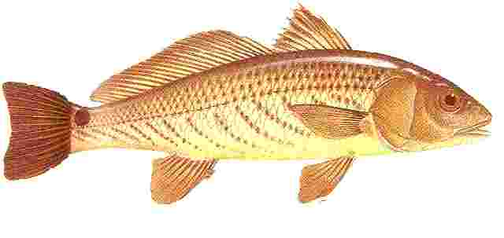
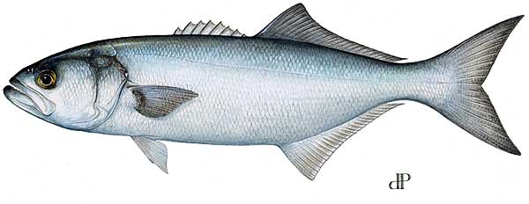
Magnuson-Stevens Fishery Management
& Conservation Act 1956
“Promote the conservation and management of marine fisheries.”
    Coastal populations
    Anadromous species
    Goal to optimize fisheries yields
EFH regulations effective 1999
Red Drum
Bluefish

Slide 13
Essential Fish Habitat
  Federal Action agency required to consult with NMFS, Habitat Conservation Division (HCD) (i.e. NOAA Fisheries) for:
    Actions with potential to adversely impact EFHs (reduction of quality or quantity)
  NMFS provides conservation recommendations
  Agency must respond (ex. Mobile District MOA)
Notes:
1. Use of existing protocols is emphasized to reduce perception of added workload.
2. Agency call on whether impact is adverse.
40 CFR 1502.25 “Agencies will to the fullest extent possible integrate environmental analysis and related surveys required by other environmental review laws and executive orders”.

Slide 14

Migratory Bird Treaty Act 1918
Prohibits harassment of listed migratory birds
Avoid areas of active nesting
Requires shorebird nesting surveys
Requires development of shorebird management plans
Notes:
836 species on the list

Slide 15
Cultural Resource Laws
Cultural resources are elements of our environment which have been made, built, altered or modified in some way, left behind as physical remains, or considered to sustain a cultural identity (both physical and non-physical), by humans
http://www.achp.gov

Slide 16



National Historic Preservation Act 1966
State Historic Preservation Officer (SHPO)
Tribal Historic Preservation Officer (THPO)
Section 106 Consultation
  Mandates procedural steps in consideration of effects
  Does not prevent action

Slide 17




Clean Water Act 1977
CWA is the principle law governing pollution control and water quality of the nation’s waterways
The main purpose is to restore/maintain the chemical, physical and biological integrity of the nation’s waters
Regulates placement of dredged or fill material in Waters of the US
Defines USACE Regulatory Authority

Slide 18
Clean Water Act 1977
Section 401- State certification required for a project to be in compliance with established effluent limitations and water quality standards of the State
Section 402 – NPDES (DA construction not use)
Section 404 – Discharge of dredged or fill material (includes effluent from upland DAs)
  Section 404(b)(1) Guidelines – USACE projects must comply
Fill (beneficial use) within ocean waters is addressed under the Clean Water Act
Notes:
Water quality standards are set by the State or in some cases by interstate regulatory commissions charged with responsibility for major streams exhibiting interstate geography. ORSANCO in the case of the Ohio River.
Proscriptive not advisory!

Slide 19

Marine Protection Research & Sanctuaries Act 1972
  Regulation of ocean dumping
  Targets degradation of the marine environment
  Establishes USACE regulatory authority over ocean disposal of dredged material
  Establishes process of designating sites in the ocean to receive dredged material that has been determined to be suitable
3 Nautical Miles (Territorial Sea)

Slide 20
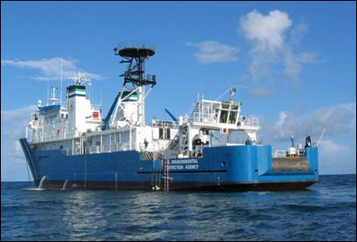
Marine Protection Research & Sanctuaries Act 1972
Section 102
  Requires EPA, in consultation with USACE, to develop Environmental Criteria for Ocean Disposal
  Designate Ocean Disposal Sites
Section 103
  Assigns USACE Specific Authority for Authorizing Ocean Disposal
  USACE selection of ocean disposal sites, where no EPA designated site exists
  USACE permitting process
  Evaluation of suitability of material for disposal
EPA’s OSV Bold
Notes:
EPA has primary responsibility for site designation. A site may be selected by USACE under MPRSA Section 103 (b), with EPA concurrence – who may disapprove the proposed disposal.

Slide 21
Coastal Barrier Resources Act 1982
Minimize loss of human life, wasteful expenditure of Federal resources, and damage to fish, wildlife, and other natural resources
Atlantic and Gulf coasts, Great Lakes
Undeveloped coastal barriers – depositional geologic feature and associated aquatic habitats
Restricts Federal financial assistance
Consultation with FWS

Slide 22
Coastal Barrier Resources Act 1982
Exemption
  Section 6(a)(2) – the maintenance or construction of improvements of existing Federal navigation channels (including the Intracoastal Waterway) and related structures (such as jetties), including the disposal of dredged materials related to such maintenance or construction
  Must have been authorized before the date on which the relevant System unit was included within the system

Slide 23
Coastal Zone Management Act 1972
Preserve, protect, develop, restore and enhance the resources of the nation’s coastal zone for current and future generations
  Coastal Zone - coastal waters to the limits of territorial seas or international boundaries
  Coastal Waters - Great Lakes, connecting waters, and waters adjacent to shorelines; i.e. bays and estuaries
  Coastal States - includes those states bordering the Great Lakes

Slide 24
Coastal Zone Management Act 1972
Section 303 - Requires cooperation with state and local governments to effect the purpose of the law
  Applicable out to 3 mile limit or to the state jurisdictional boundary
Section 307 – Assure projects consistent with approved state plan to the maximum extent practical
  Consistency Determination (CD)
Notes:
Assurance is to the maximum extent practicable. The Corps makes the Call on what is practicable. Example-policy of no hardened structures, if the NMFS wants something different you will have to provide it. The Corps makes the final call.

Slide 25
Coastal Zone Management Act 1972
CD - Includes an evaluation of the relevant provisions of the State’s Management Plan, project description, project effects and supporting data for the conclusions of the CCD
  Agency makes call on conformity, requests State concurrence
  Should be included in NEPA document. See 40 CFR 1502.25
Conflict Resolution Process – mediation chaired by Secretary of Commerce with cabinet level agency representation
Notes:
Add to appropriate NEPA document and circulate

Slide 26
Clean Air Act 1970
Protection of public health and welfare by the control of air pollution at its source
“General Conformity Rule”
http://www.epa.gov/ebtpages/air.html
Notes:
Most metropolitan have problems meeting conformity with regulations. Did you know the volcano on the Big Island of Hawaii creates a non-attainment zone on the island.
The public law you have cited is not just applicable to general conformity, but rather addresses other clean air act issues. The CAA amendments of 1990 were very sweeping in nature and added many additional requirements to the CAA. You might want to delete the “General Conformity Rule” from this slide and add it to slide six to indicate it is part of the overall clean air act the one portion you are actually covering in these slides.

Slide 27
Clean Air Act 1970
States required to develop Implementation Plans (SIP) to obtain and maintain compliance with National Ambient Air Quality Standards (NAAQS)
  Strategy by which the state plans to meet and maintain (NAAQS) requirements
  Budgets emission quotas for various sources
  EPA approval required
Agency determines applicability/conformity with SIP
  Consultation with State/EPA
  Analysis and reporting
Notes:
IF SIPs fail you will have to comply with a FIP Federal Implementation Plan prepared by EPA
As of now, all states have functioning SIPS…. however, various Federal requirements may not yet be incorporated or approved by EPA, in which case, the federal regulation applies.

Slide 28
Deep Draft Projects in Mobile District
Panama City Harbor, FL
Pensacola Harbor, FL
Mobile Harbor, AL
Pascagoula Harbor, MS
Gulfport Harbor, MS

Slide 29
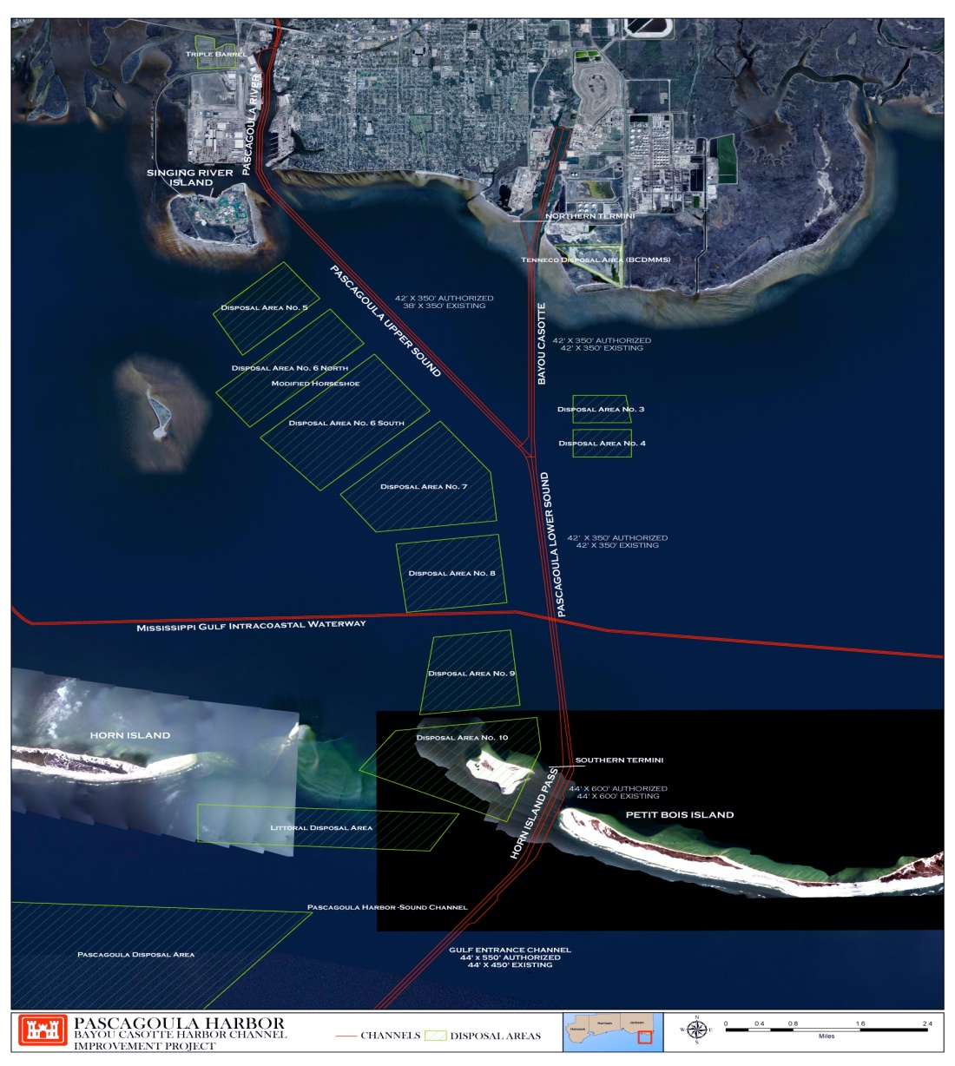
PASCAGOULA HARBOR – OVERVIEW
Five Segments -
Pascagoula Upper River
  - A Channel 16 feet deep by 70 feet wide from River Mile 0.0 to 5.0 (~29,500 feet)
2. Pascagoula Inner Harbor & River
  A Channel 38 feet deep by 350 feet wide with a turning basin 38 feet deep, 2,000 feet long, and 950 feet wide on the west side below Railroad Bridge
3. Bayou Casotte Inner Harbor
  A Channel 42 feet deep by 350 feet wide and a turning basin 42 feet deep, 1,000 feet wide and 1,750 feet long

Slide 30
PASCAGOULA HARBOR – OVERVIEW
Five Segments Cont. –
4. Mississippi Sound – Lower Pascagoula, Upper Pascagoula & Bayou Casotte
  A Channel 42 feet deep by 350 feet wide along the Lower Pascagoula & Bayou Casotte
  A Channel 38 feet deep by 350 feet wide along the Upper Pascagoula
5. Pascagoula Harbor Bar Channel & Horn Island Pass
  A Channel 44 feet deep by 450 feet wide from GOM to south end of Horn Island Pass
  A Channel 44 feet deep by 600 feet wide (~4.5 miles) including impounding area for littoral drift, 44 feet deep, 600 feet wide, and 1,500 feet long

Slide 31
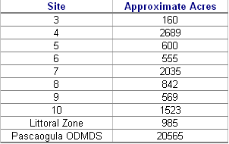
PASCAGOULA HARBOR – OVERVIEW

Slide 35
Mobile Harbor Authorization

Slide 36
Existing Project Dimensions
Existing project provides for
  47-foot* by 600-foot channel about 1.5 miles long across Mobile Bar
  45-foot* by 400-foot channel in Mobile Bay to mouth of Mobile River
  40-foot* channel in Mobile River to highway bridge, varying from 500 to 775 feet wide
  Turning basin 40 feet***, 2,500 feet long, and 800 to 1,000 feet wide, opposite Alabama State Docks
  Turning basin 40 feet**, 1,000 feet wide, and 1,600 feet long opposite Magazine Point
  Turning basin 45 feet** between Pinto and Little Sand Islands, 1,350 feet from the centerline of the existing channel
  Extensions deepen from 38 feet to 45 feet* approximately 3,300 feet on the east side of the upper Mobile Harbor Channel dredging
* plus 2 feet advanced maintenance plus 2 feet allowable overdepth
** plus 4 feet advanced maintenance plus 2 feet allowable overdepth
*** plus 8 feet advanced maintenance plus 2 feet allowable overdepth

Slide 37
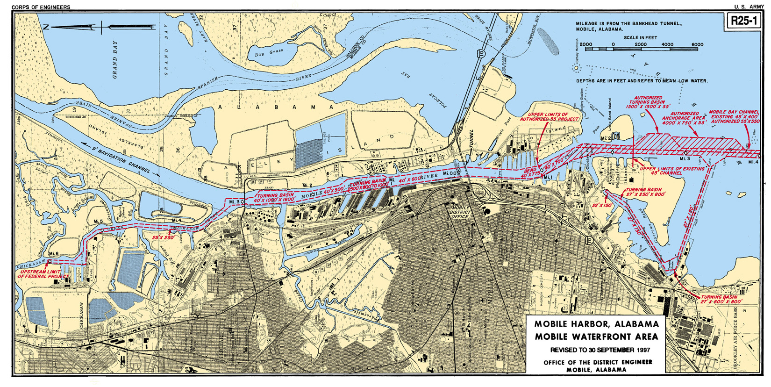
River Channel
ALCOA
Mud Lakes 6 & 7
North Pinto
South Blakely
ODMDS
6
7
North Blakely

Slide 38
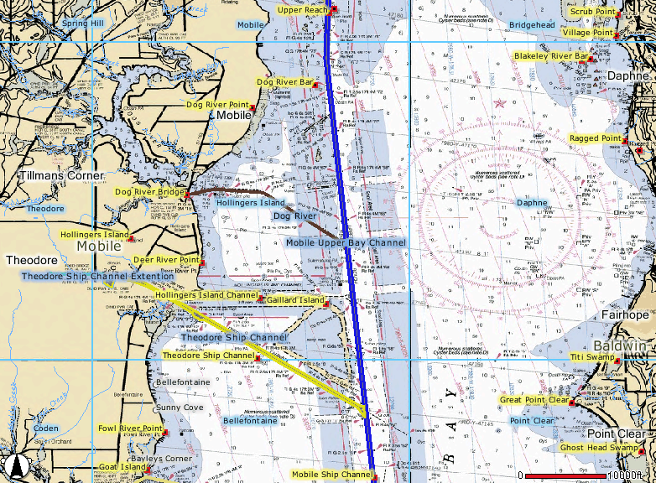
Upper Bay Channel
Ocean Disposal
Mobile North ODMDS

Slide 39
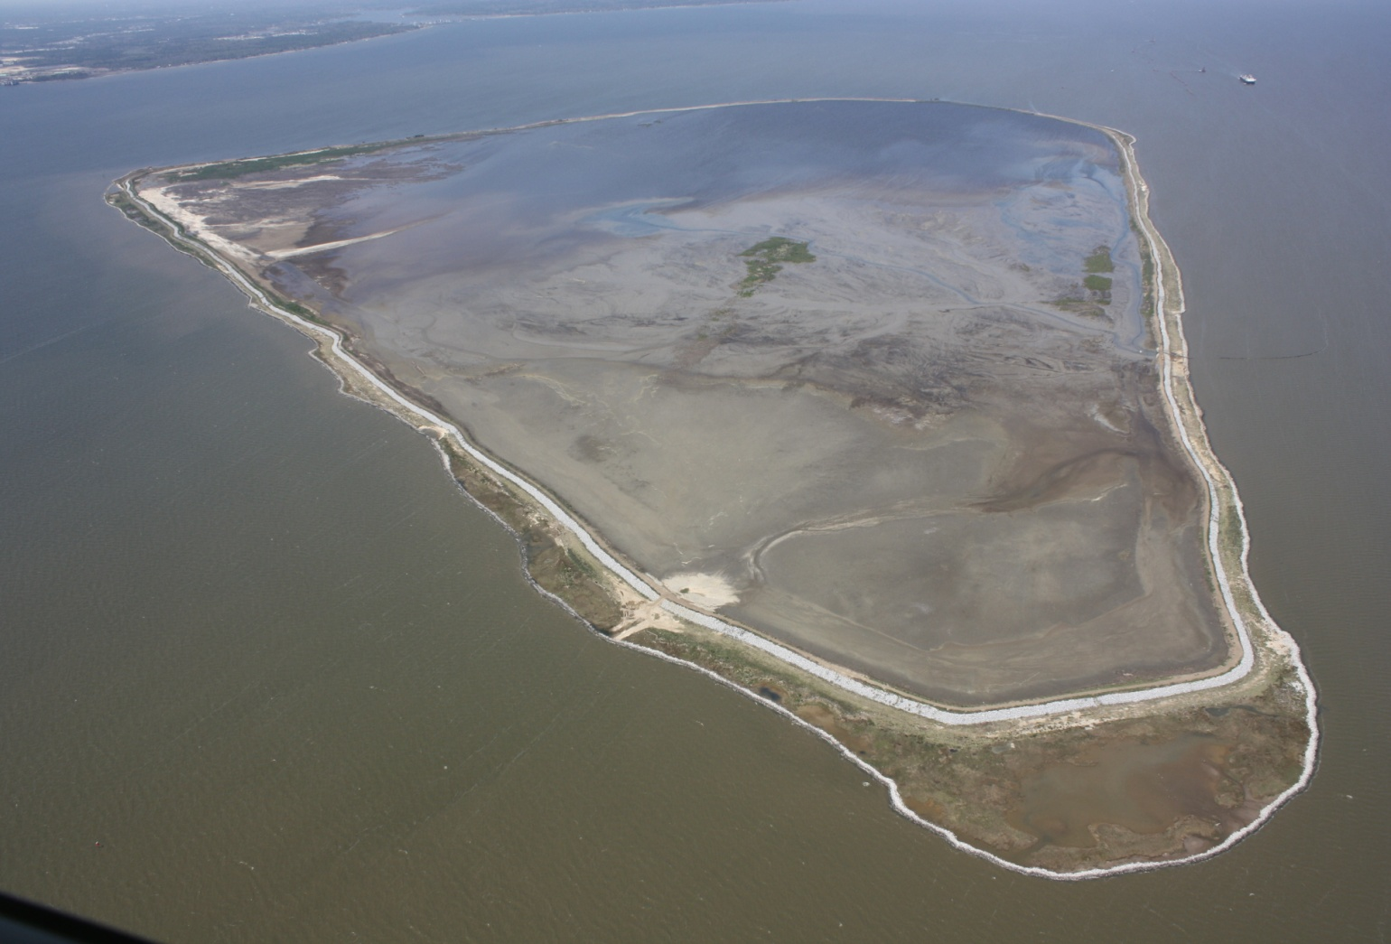
Gaillard Island

Slide 40
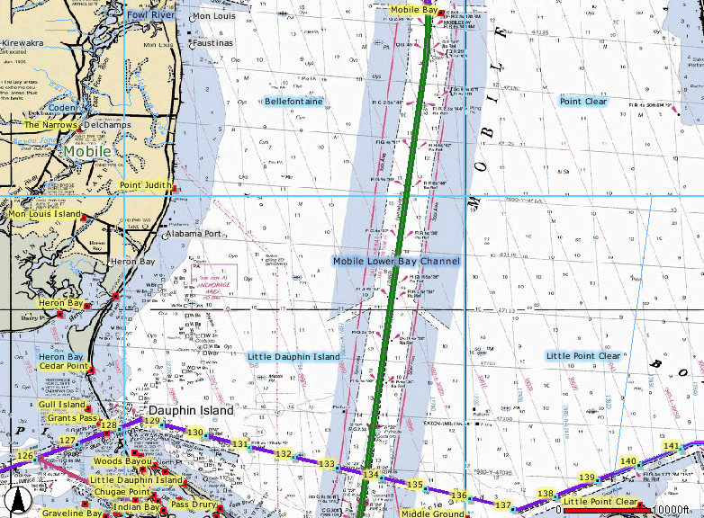
Lower Bay Channel
Ocean Disposal Mobile North ODMDS

Slide 41
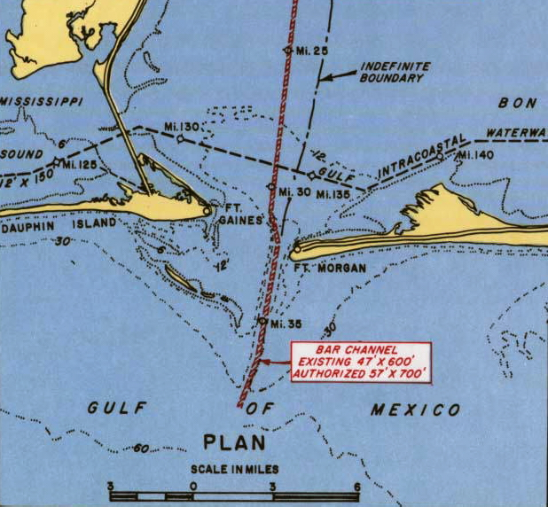
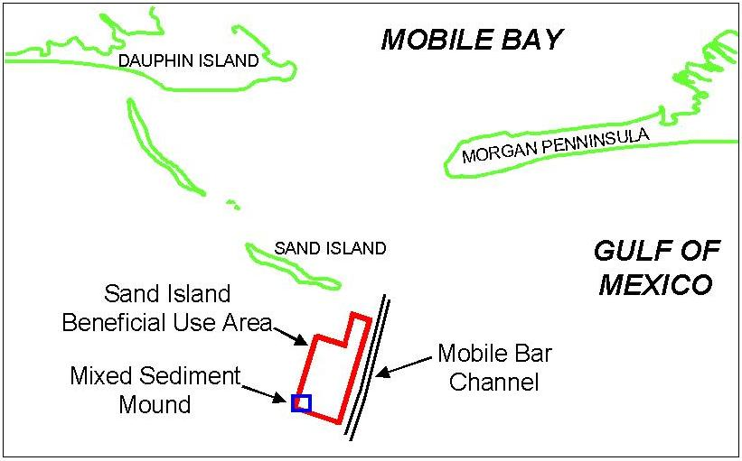
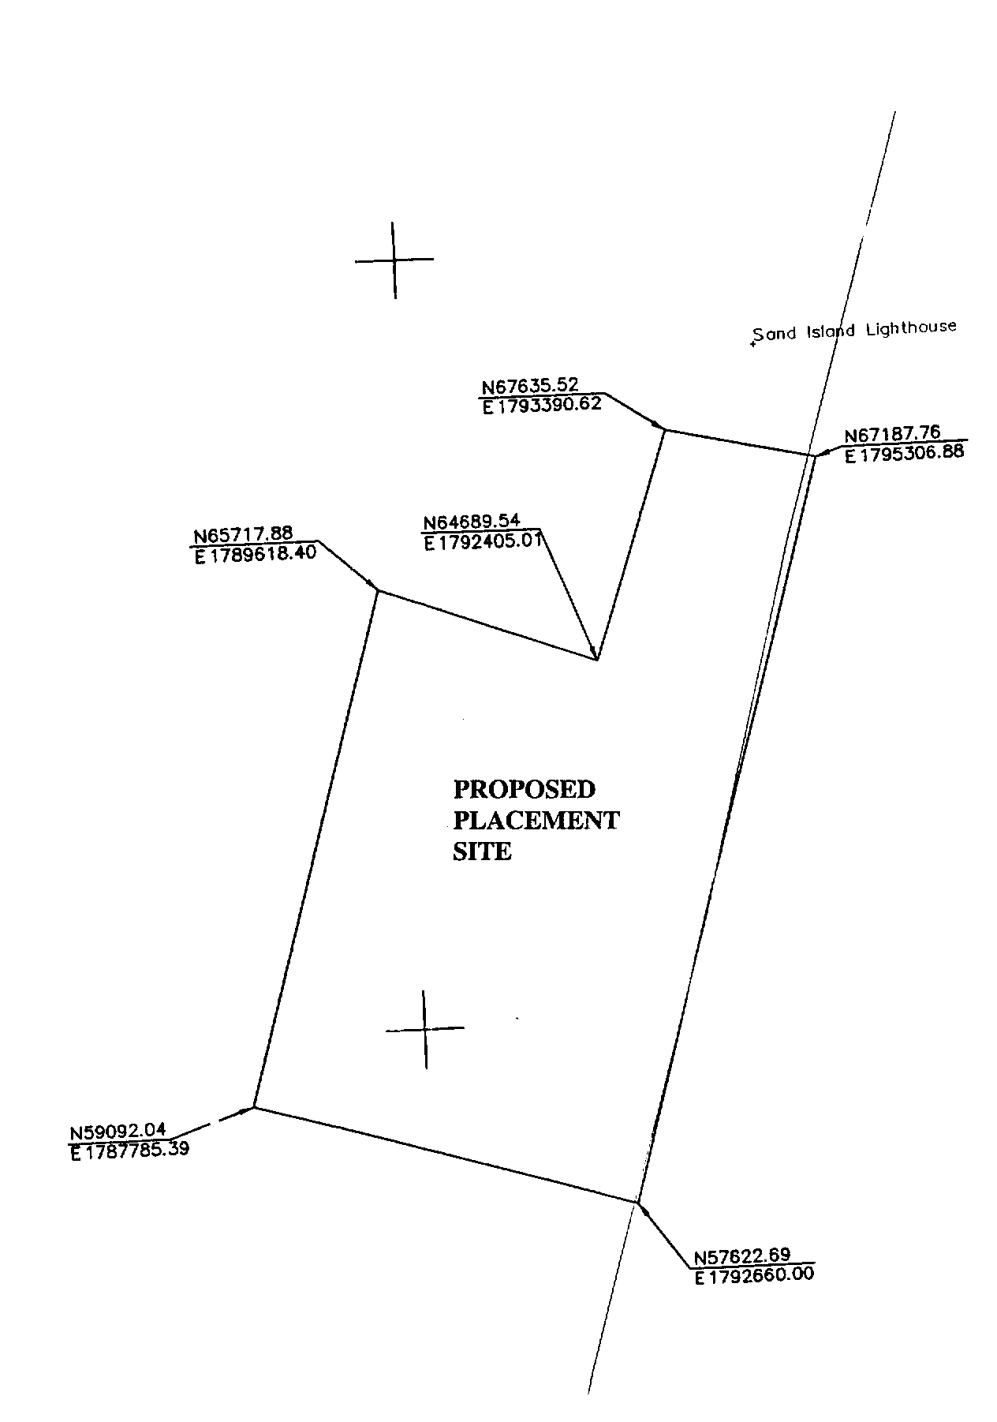
Bar Channel
Sand Island Lighthouse
SIBUA

Slide 42
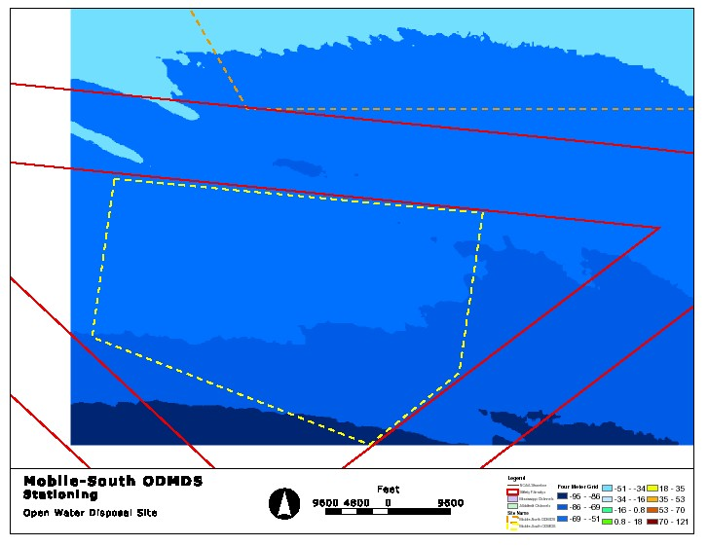
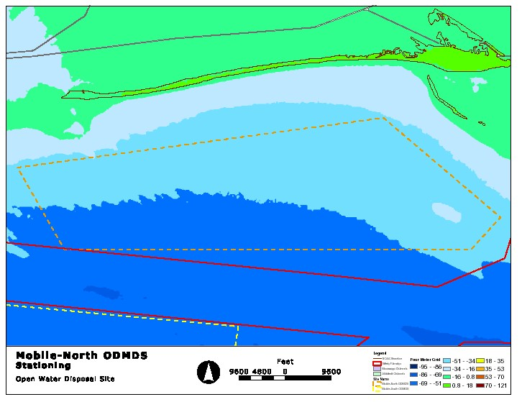

Slide 43
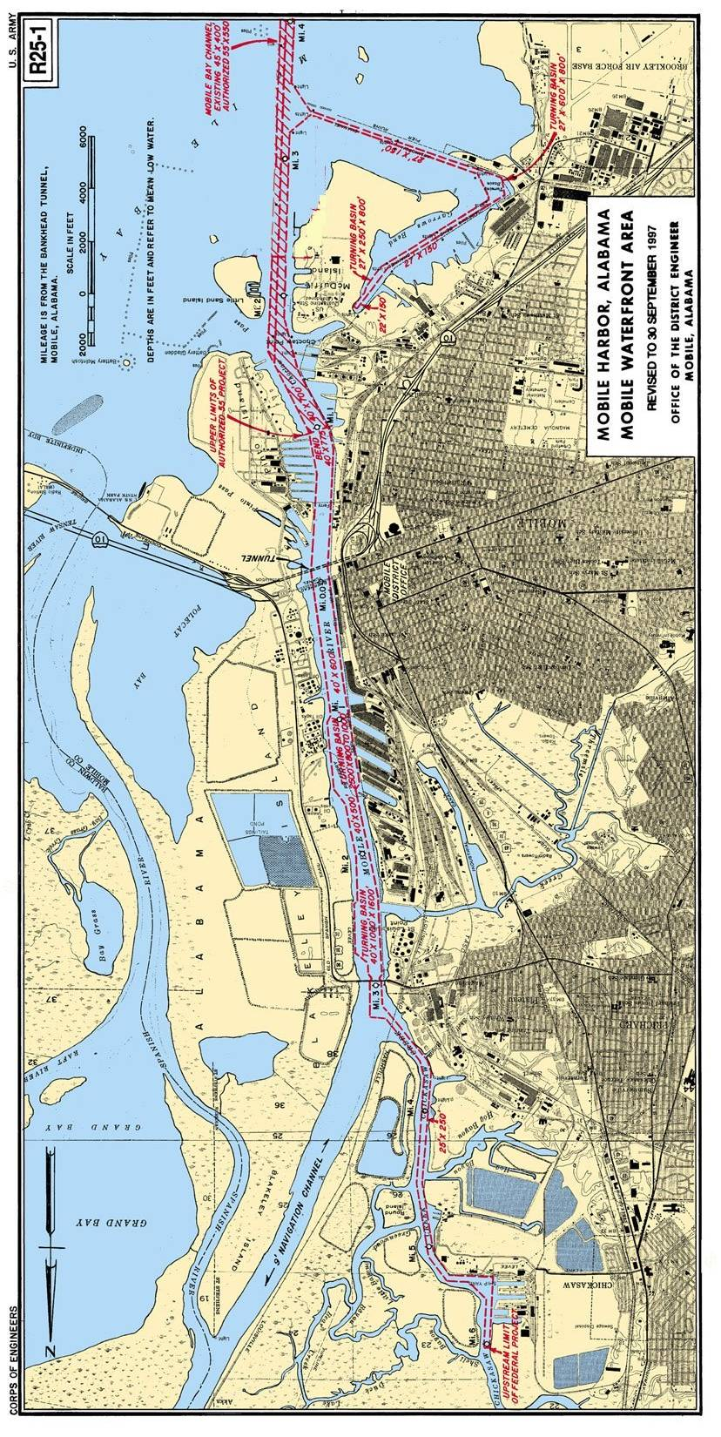
Location of Turning Basin
Turning Basin Area
Approximate Location of Garrows Bend Disposal Area

Slide 44
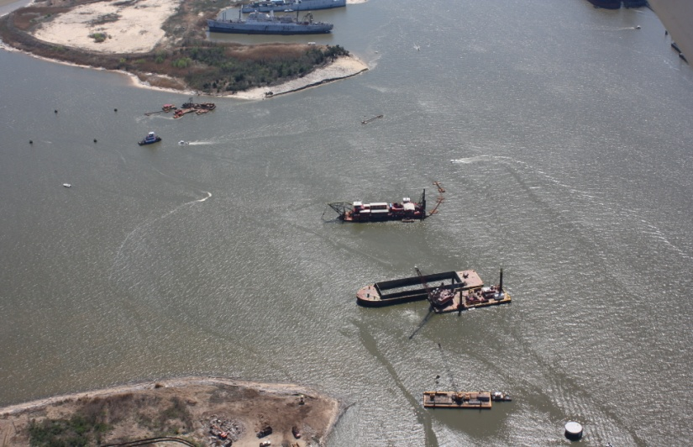
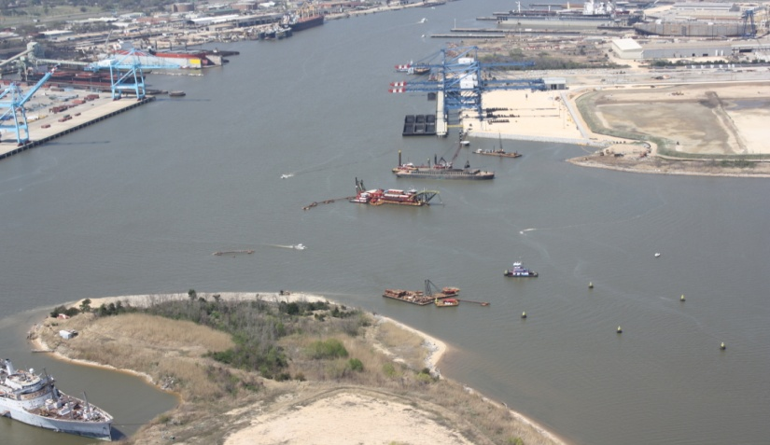
Mobile Harbor Turning Basin – New Work

Slide 47
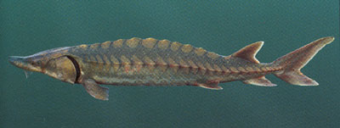
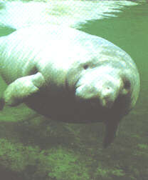
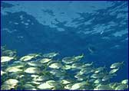
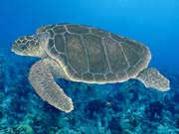
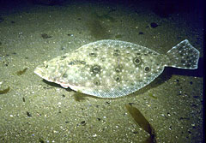
ESA Section 7 & MSFCMA
Gulf sturgeon
Manatee
Sea Turtles
Essential Fish Habitat
Alabama red-bellied turtles

Slide 48
Gulfport Harbor Navigation Channel
Proposed Improvements
Channel Segment | Authorized Dimension | Existing Dimension | Proposed Action
Bar Channel | Width – 400’ Depth – 38’ | Width – 300’ Depth – 38’ | Width – 400’
Sound Channel | Width – 300’ Depth – 36’ | Width – 220’ Depth – 36’ | Width – 300’

Slide 49
Pre-dredging Characterization Studies
Characterization studies were performed 2005
Guidance and procedures defining requirements include:
  Inland testing manual
  Ocean testing manual
  QA/QC guidance for dredged material evaluations
  Methods for Collection, Storage, and Manipulation of Sediment for Chemical and Toxicological Analyses

Slide 50
Characterization Studies
Collected sediment core samples at 15 locations along the channel from 5’ to 28’ below the sediment/water interface
Characterized water column conditions during survey
Performed chemical analyses on sediment samples
Conducted chemical analyses on elutriate samples
Conducted toxicity tests on sediment and water samples
Performed bioaccumulation studies on sediments

Slide 51
Gulfport Harbor Navigation Channel
Proposed Improvements
Changes in Mississippi Sound
  Increase width by 80’ for approximately 11 miles
  Dredge ~107 acres of undisturbed bottom
Changes in Ship Island Pass
  Increase width by 100’ for approximately 10 miles
  Dredge ~97 acres of undisturbed bottom
Dredged material disposal requirements
  Generate slightly more than 3.8 million cubic yards

Slide 52
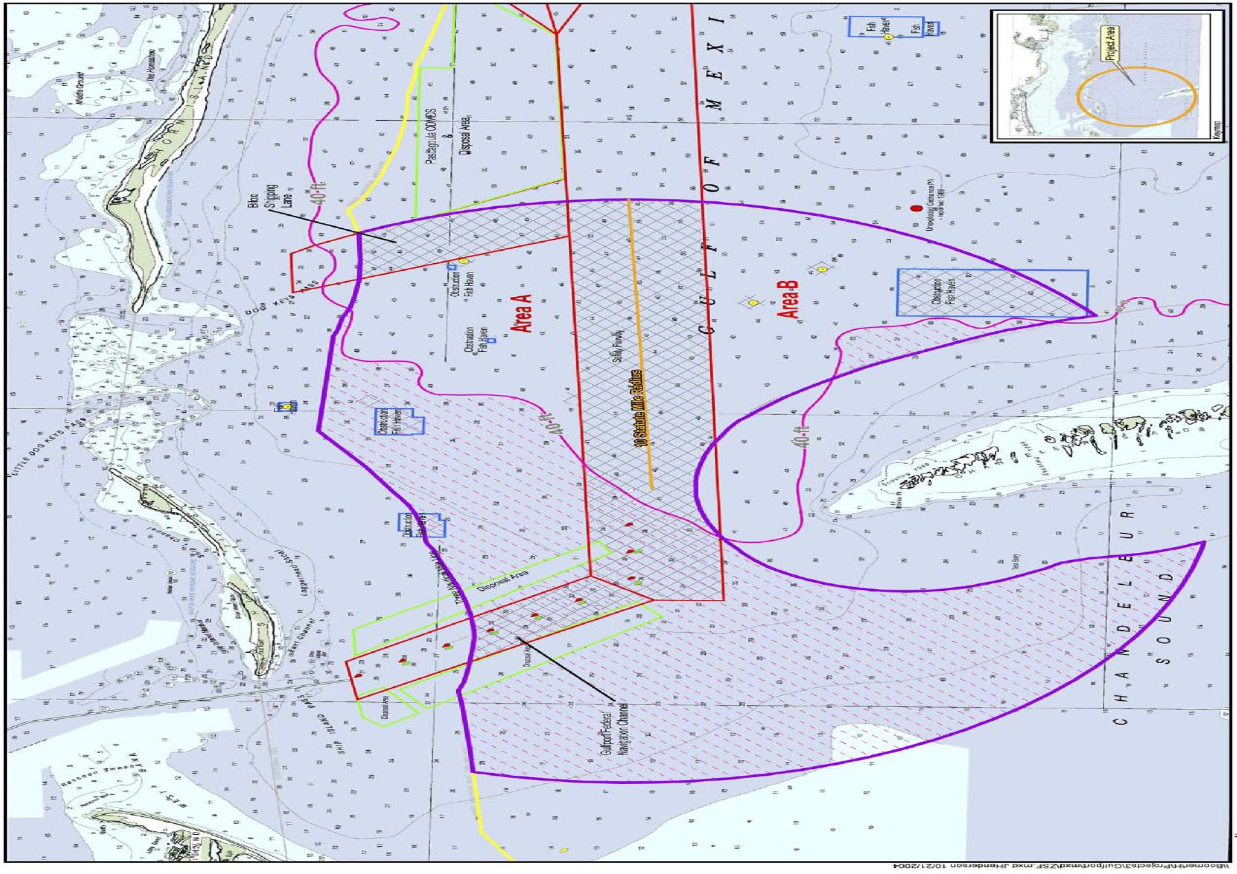

Slide 53
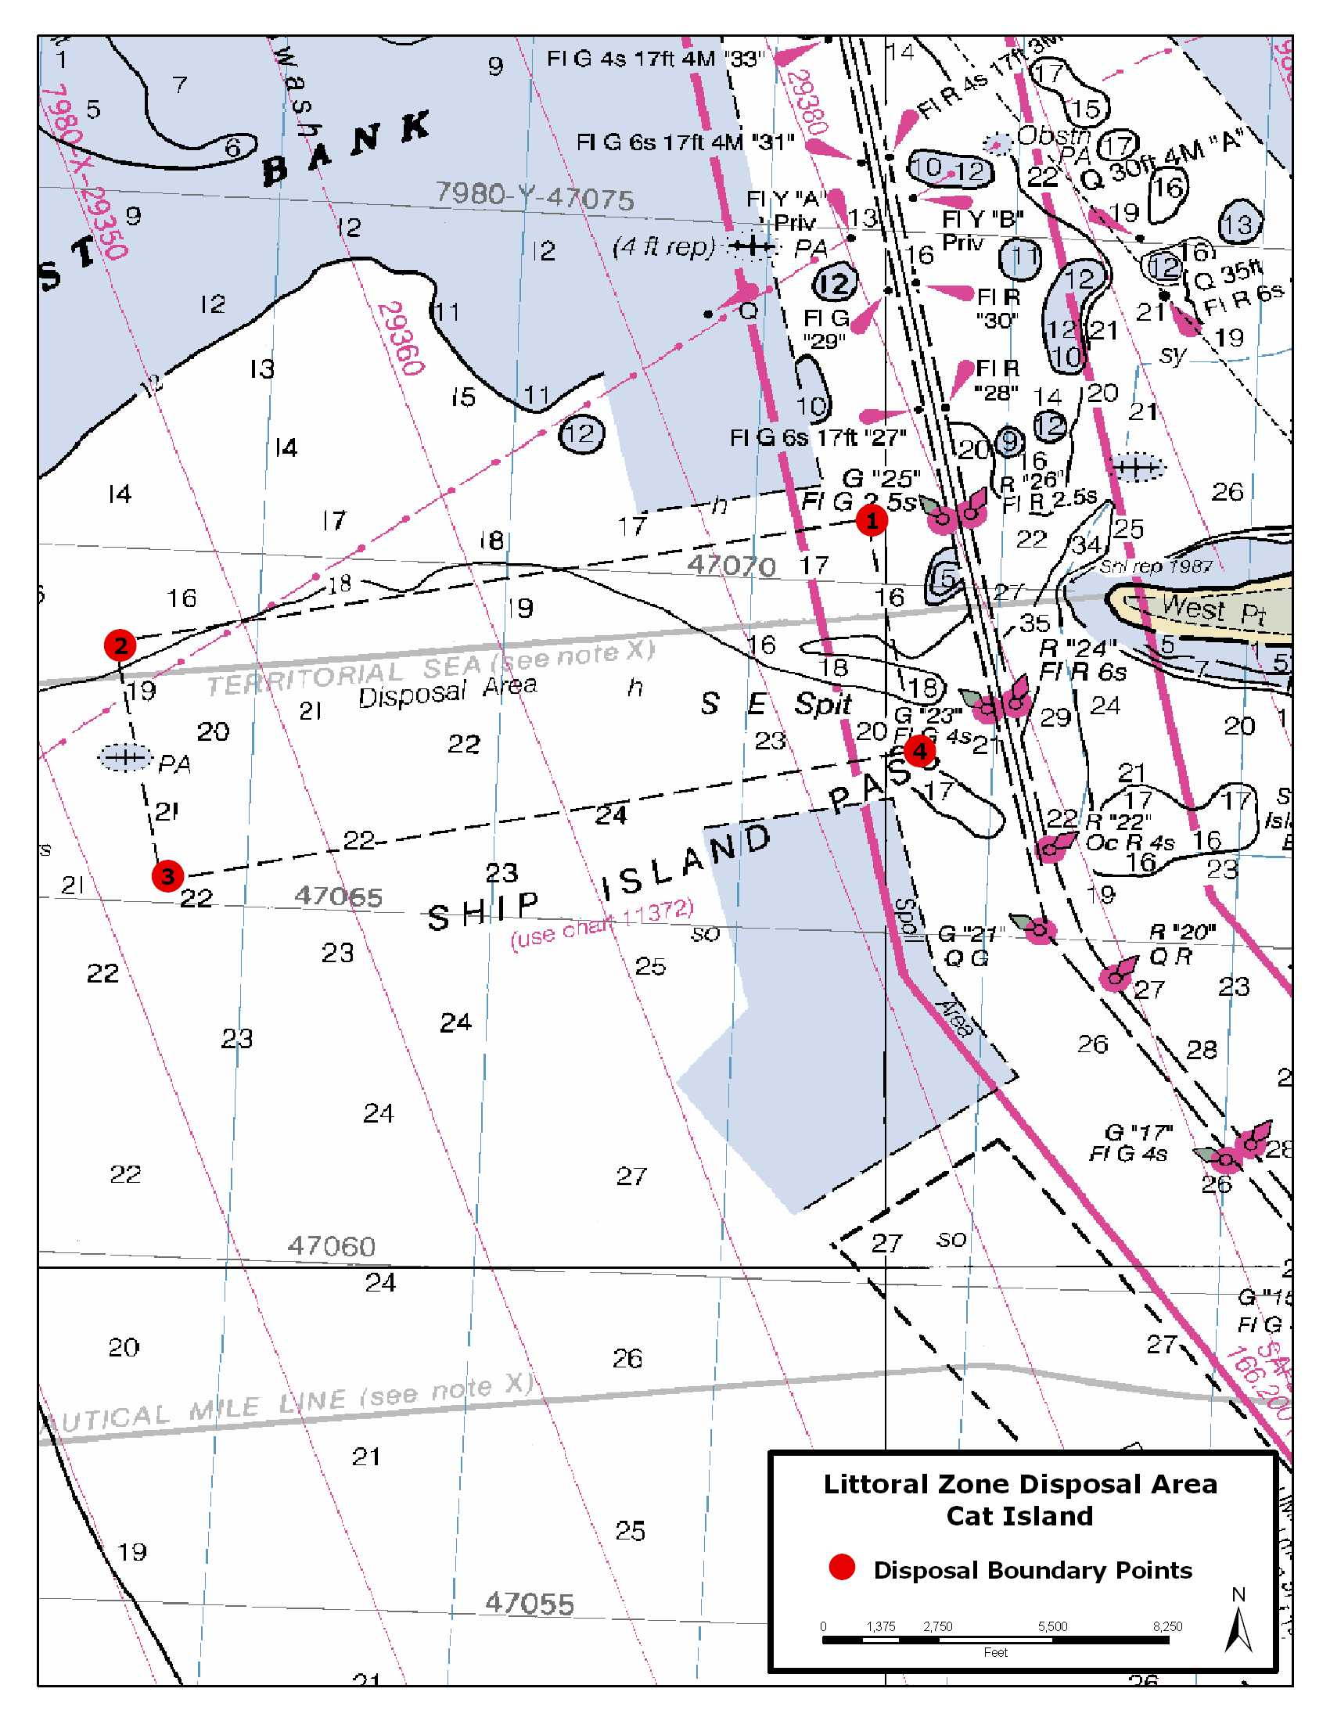
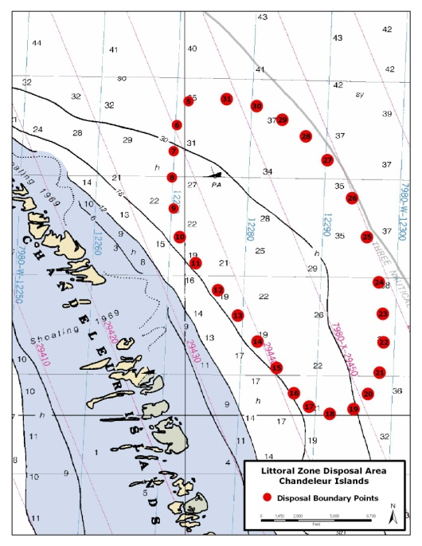


Slide 54
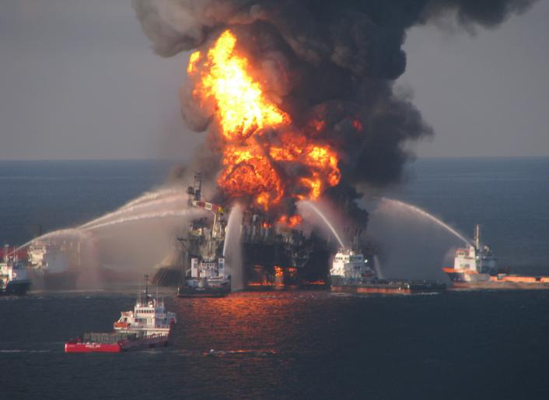
Change Happens
Deepwater Horizon Oil Spill on April 20th 2010

